Slide 1

It’s Me Parrot Rakhy

Slide 2
basic sys Python + DBMS machine learning data science web development video editing ai expert tools network access

Slide 3
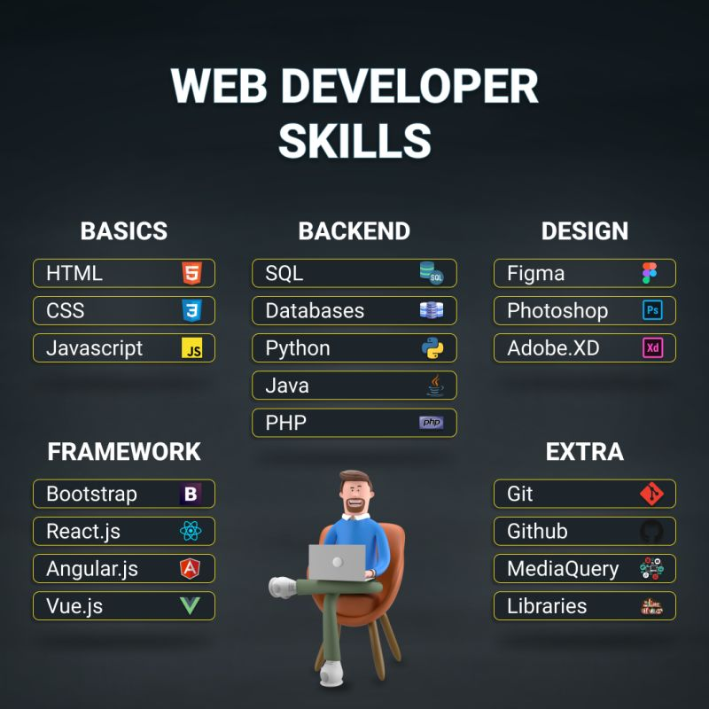

Slide 4
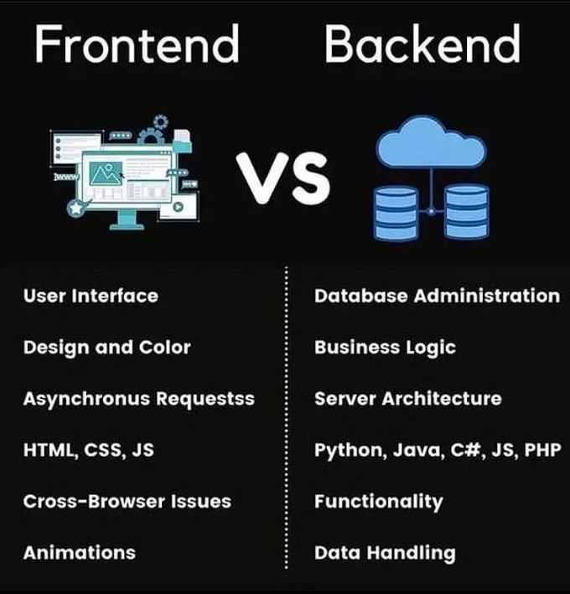

Slide 5
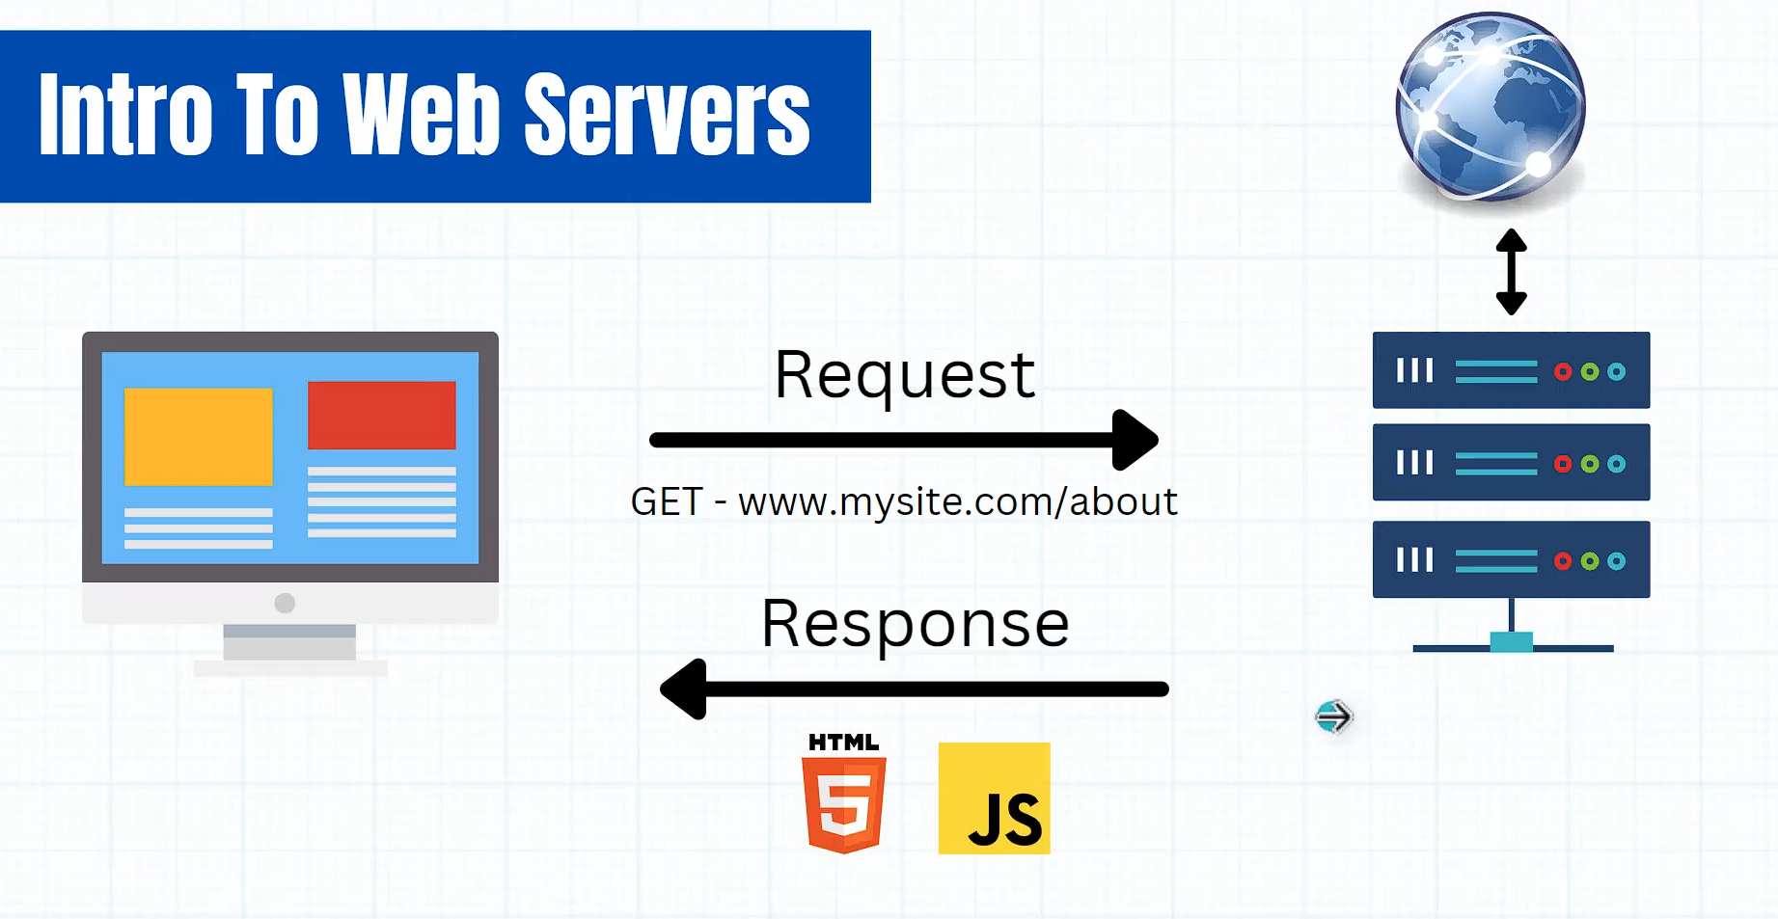

Slide 6
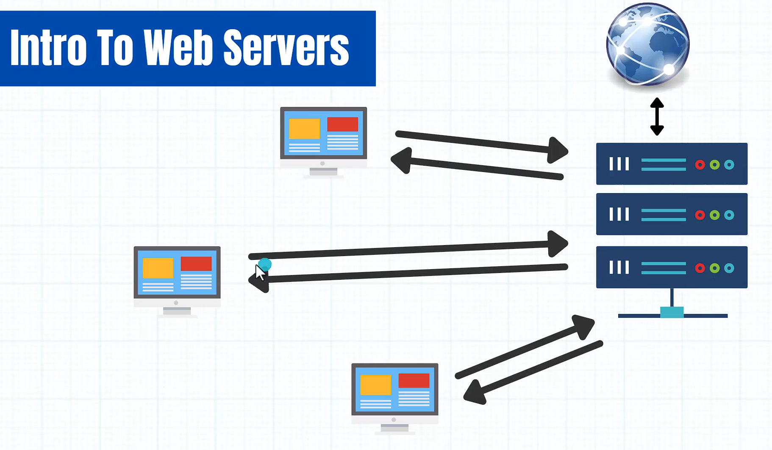

Slide 7
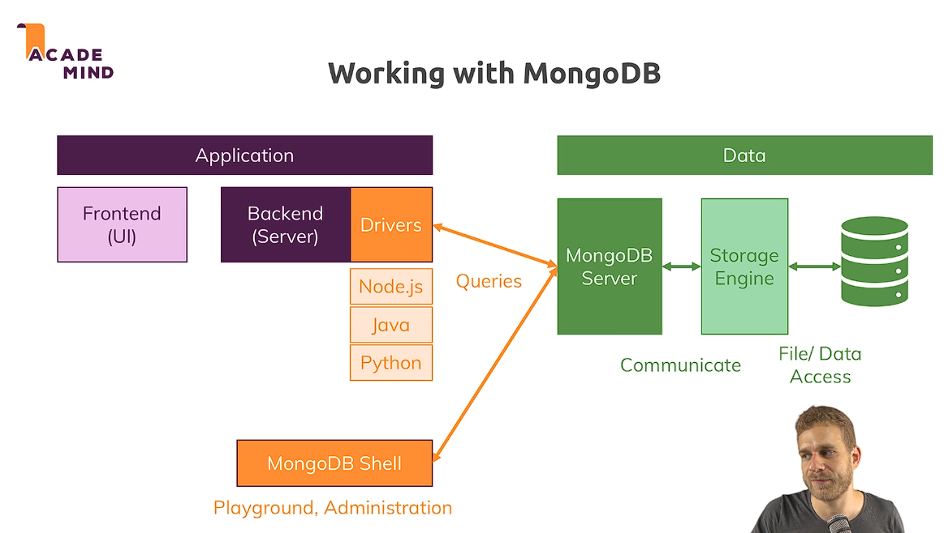

Slide 8
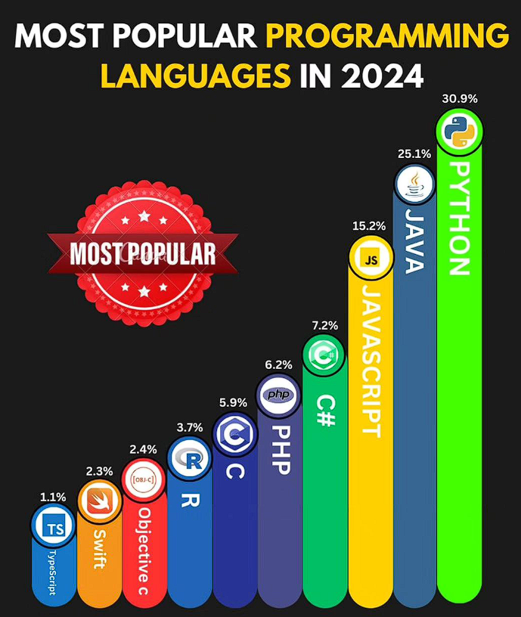

Slide 9
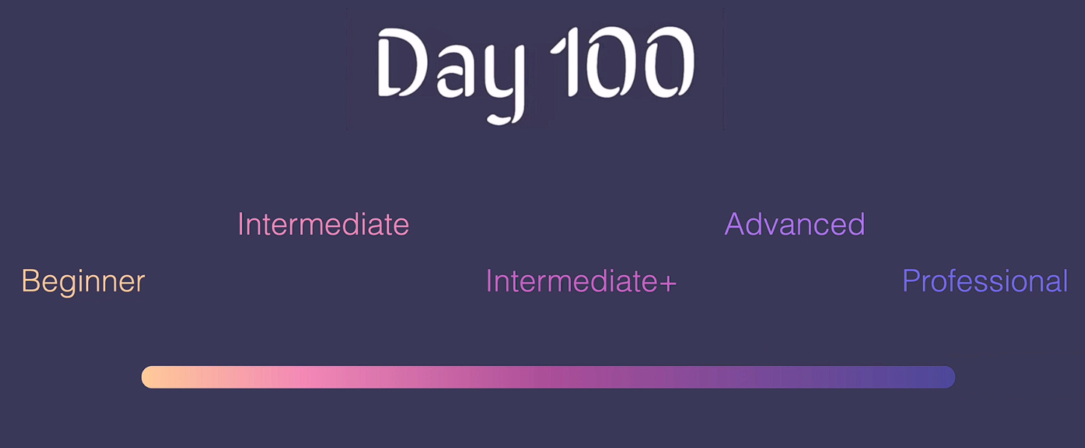

Slide 10
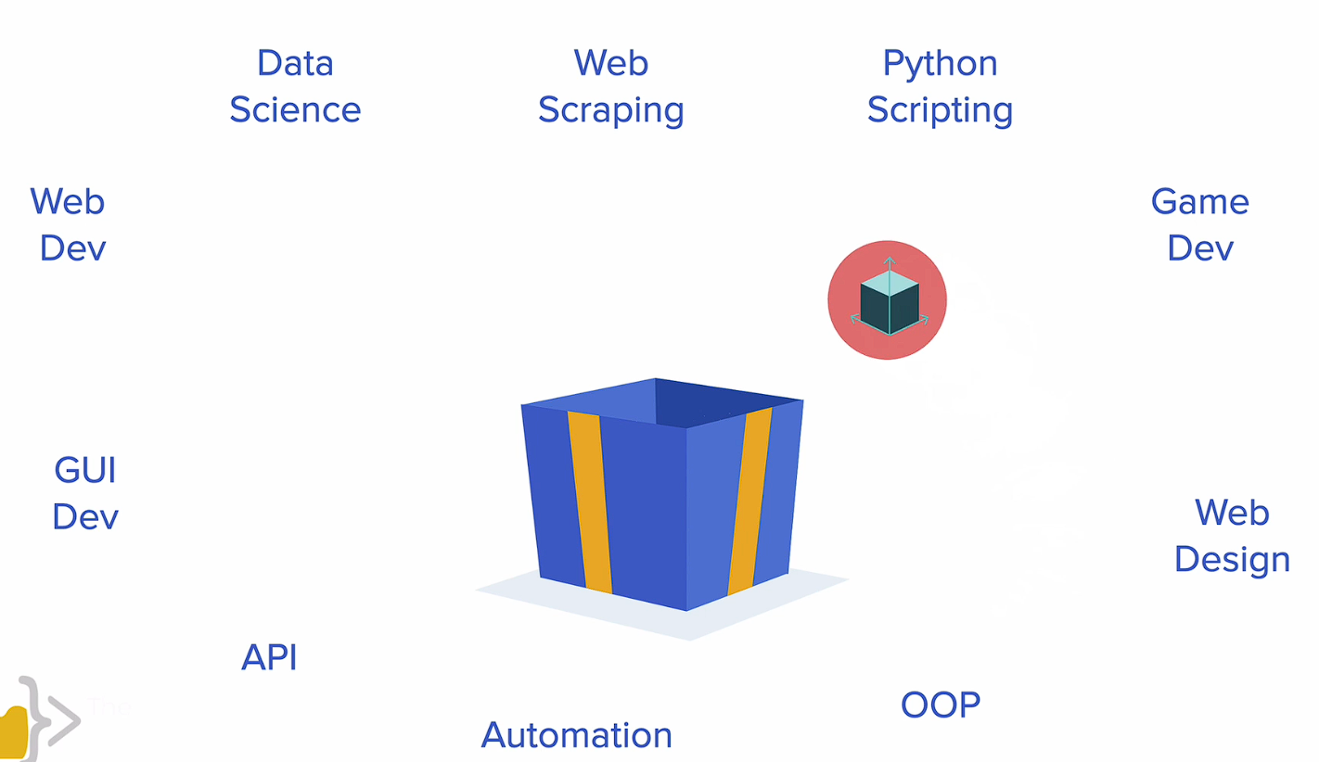

Slide 11
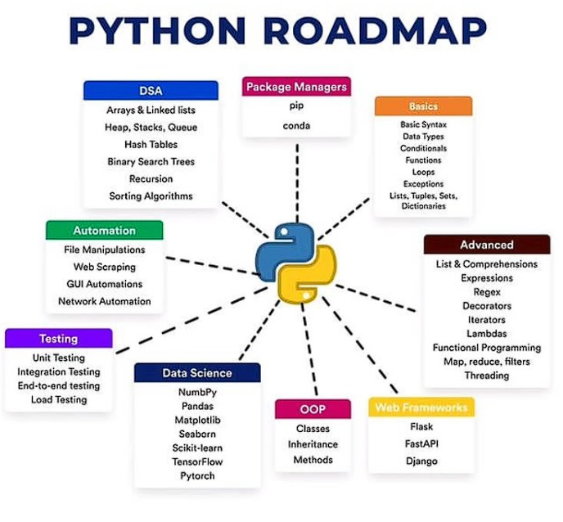

Slide 12
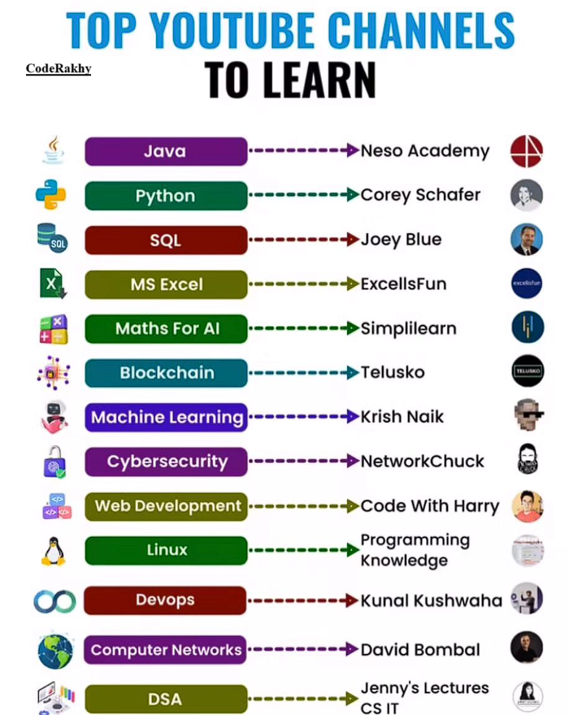

Slide 13
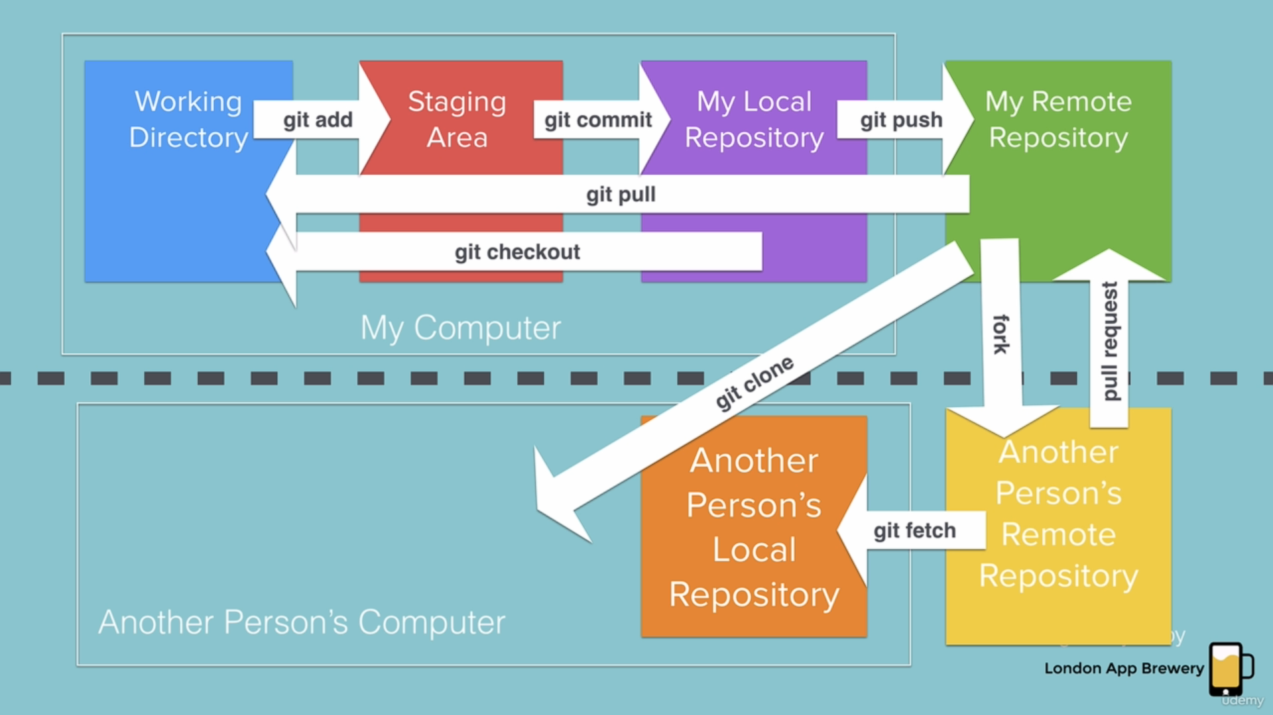
Git Commands

Slide 14
Ai tools

Slide 15
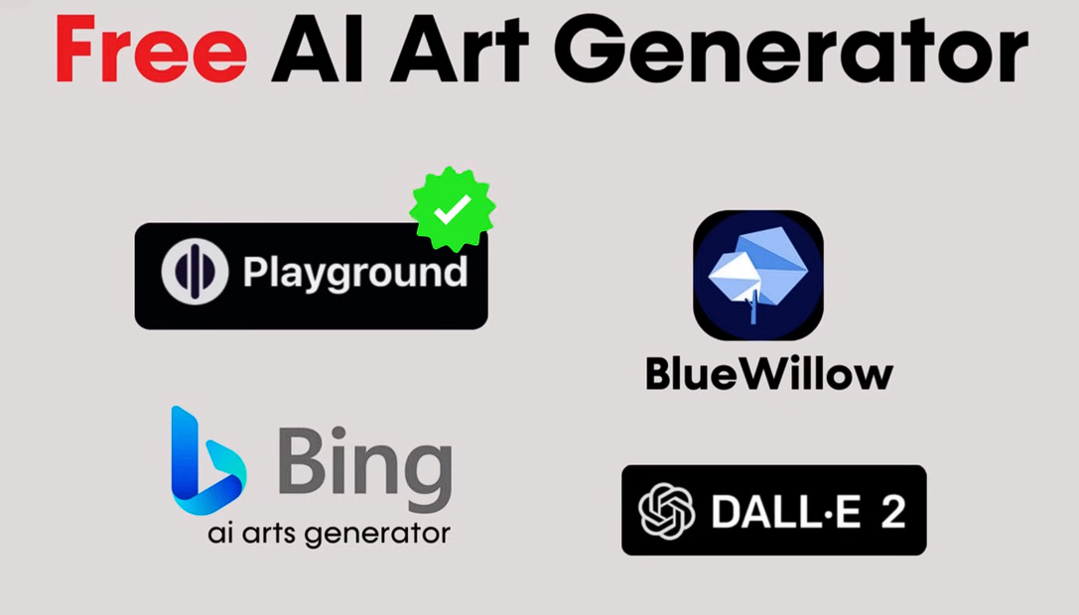

Slide 16


Slide 17
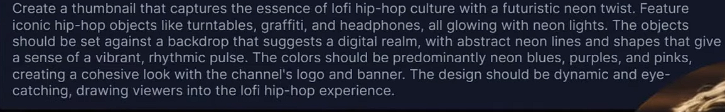
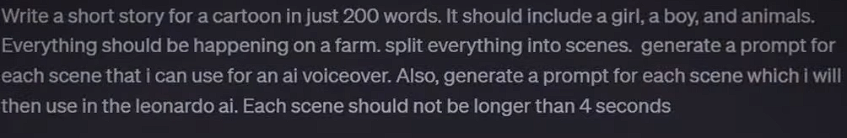
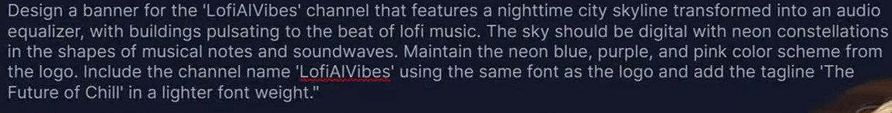
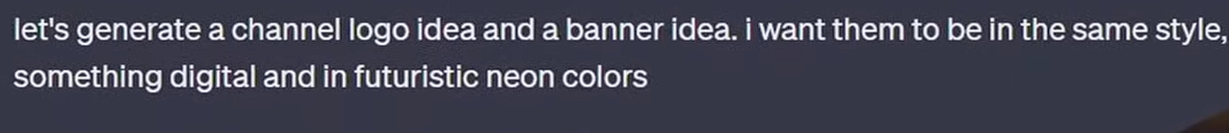
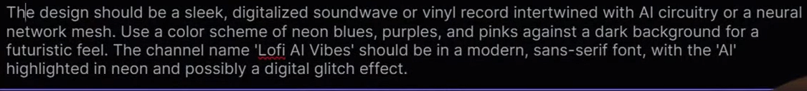
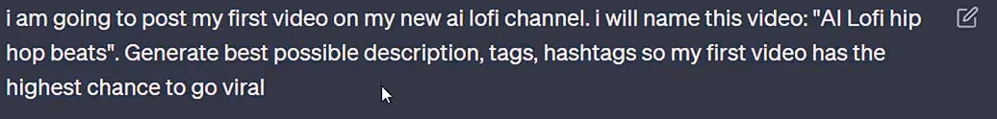

Slide 18
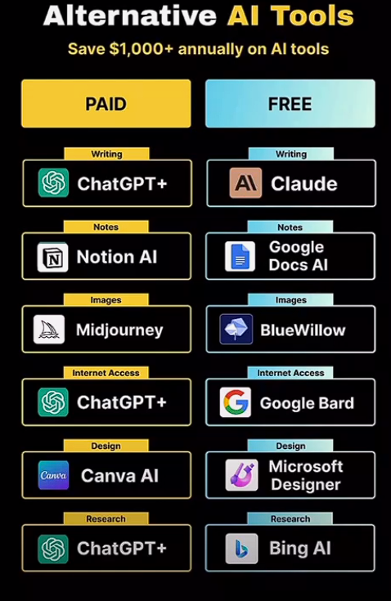

Slide 19
Tips & Tricks
Fake Emails
VPN security
Sharing Screens
Storing Data -- like Clouds
Searching Anyonmsoly – Tor Browser
Latest Updates related to AI and Stock or Financial related info etc. ( YT / Google)
Starting Your Business / YT Channel

Slide 20

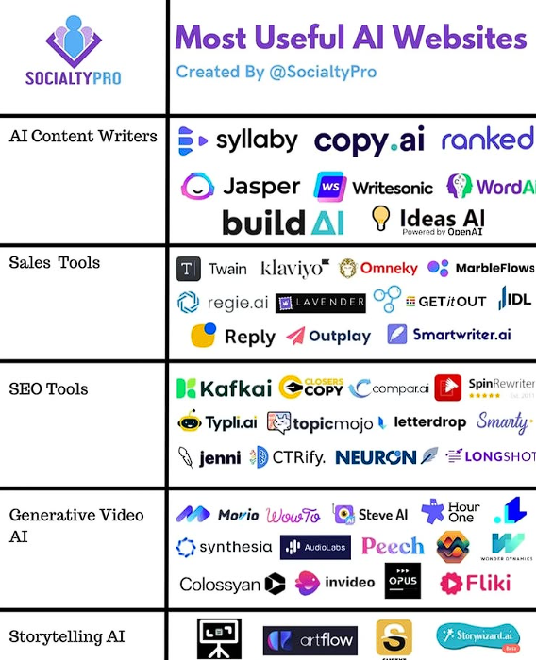
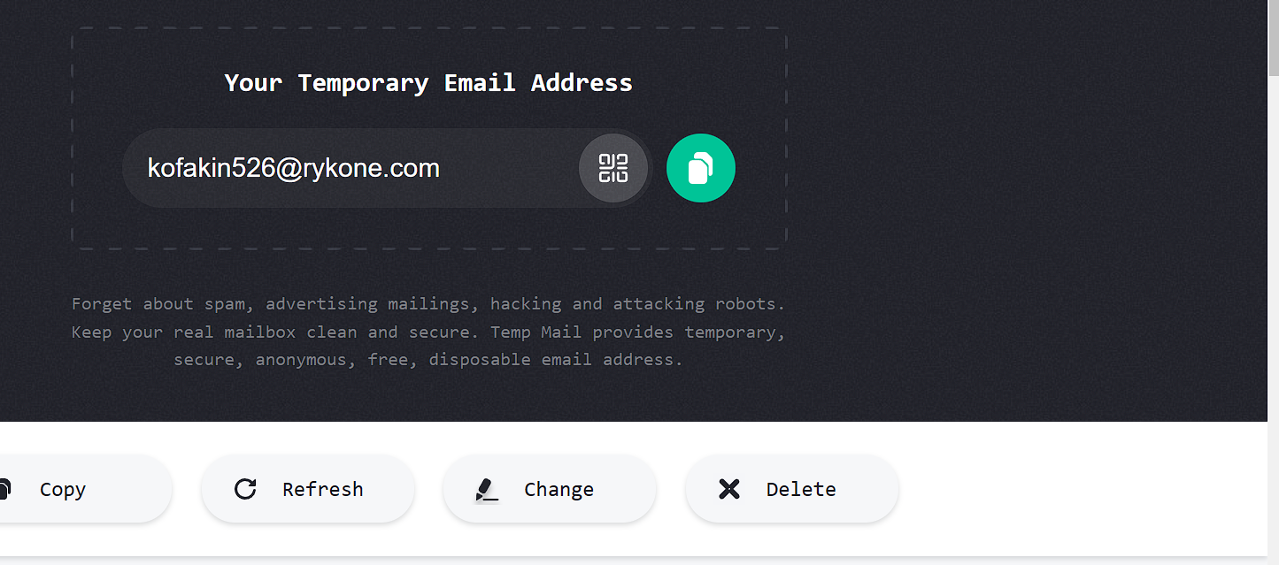





Slide 21
Resource links
If you feel like practicing your Python skills, check out these websites: https://codewars.com/
https://exercism.org/
https://leetcode.com/
https://hackerrank.com/
https://py.checkio.org/
https://www.codingame.com/

Slide 22
END

Slide 23
AI Tools
Day 1 – chatgpt ( ask anything you want)
Day 2 – suno.ai ( for music)
Day 3 -- lenoardo.ai ( for Image generating)
Day 4 – gamma.app ( for ppt presentations using AI)

Slide 24
Network & privacy tricks
Temporay Emails --- https://temp-mail.org/en/
Check your email is secure ---- https://haveibeenpwned.com/
typing test ---- https://keybr.com

Slide 25
Beginner’s level successfully Completed

Slide 26
Intermediate level Starts from here

Slide 27
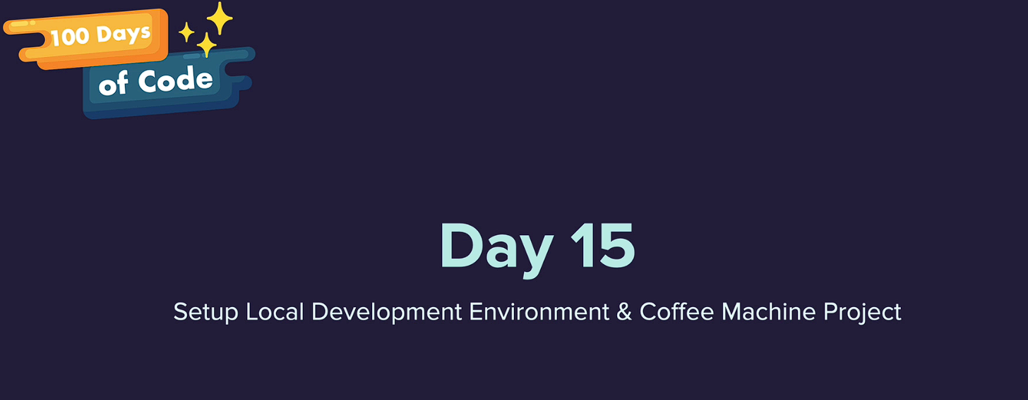

Slide 28


Slide 29
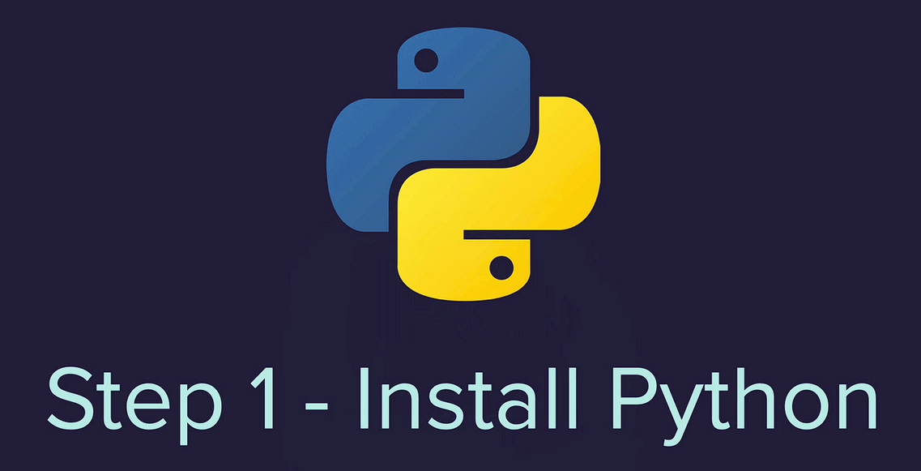
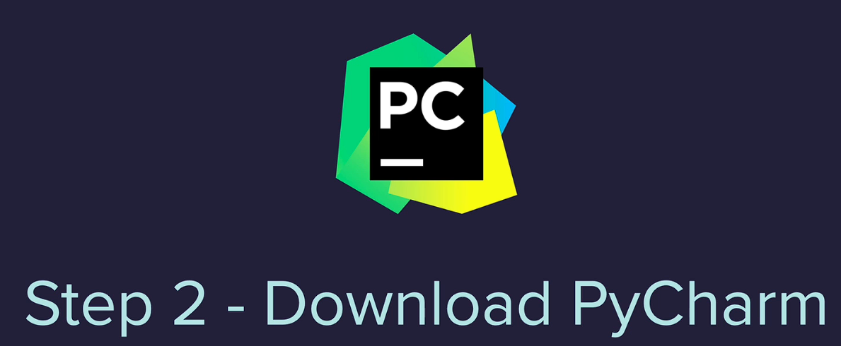
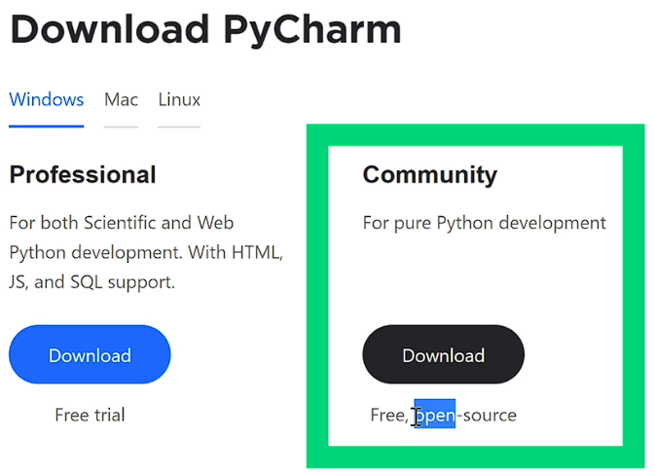
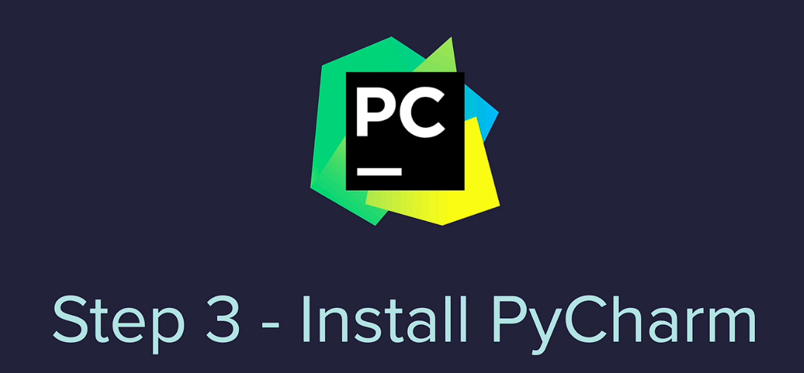

Slide 30
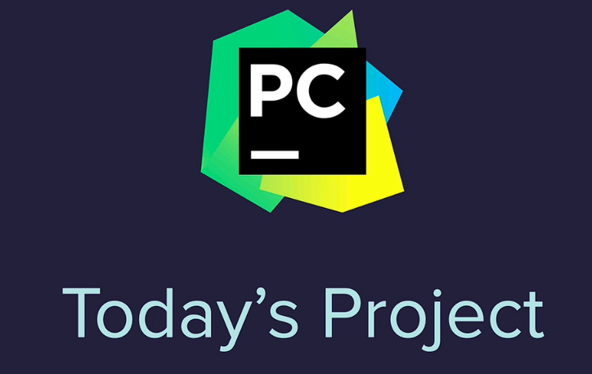

Slide 31
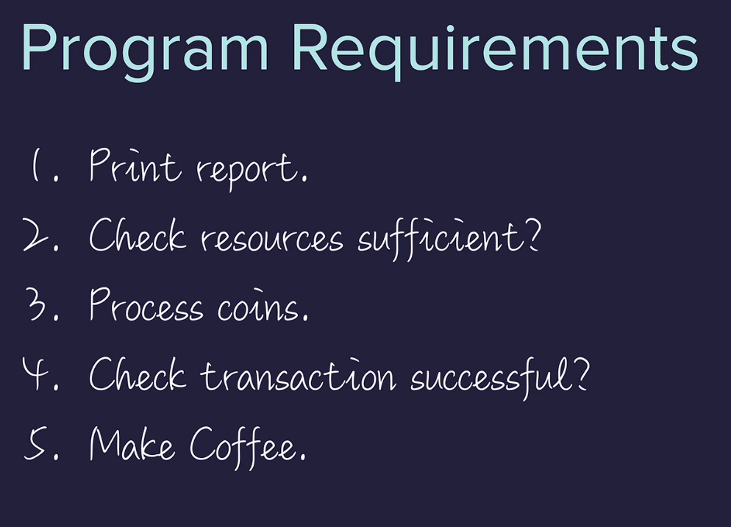

Slide 32
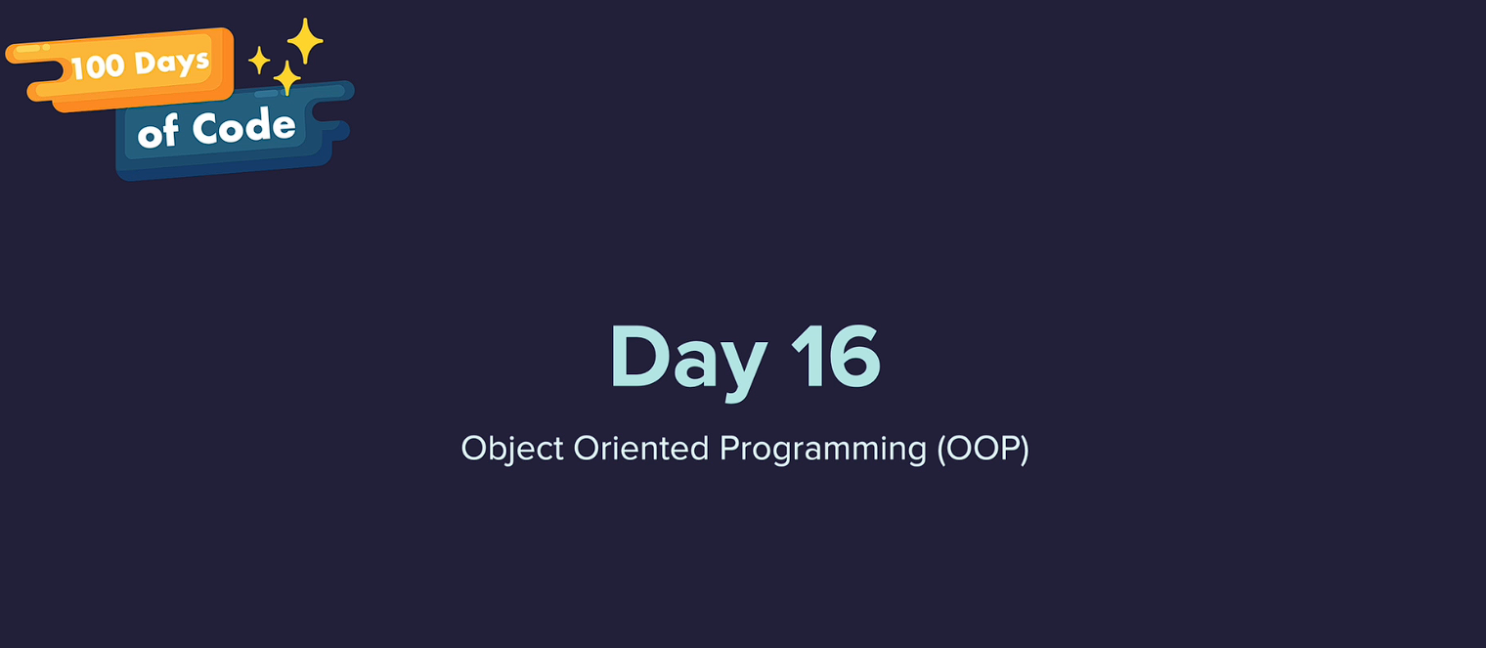

Slide 33
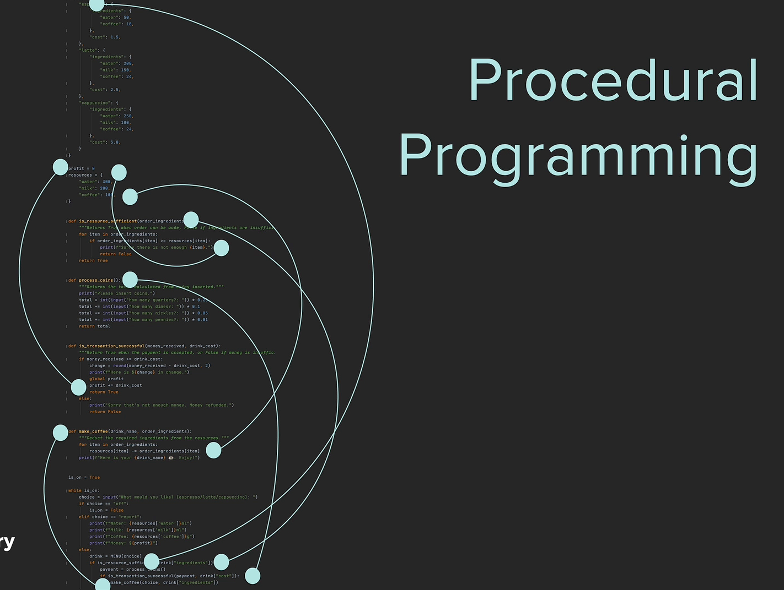

Slide 34
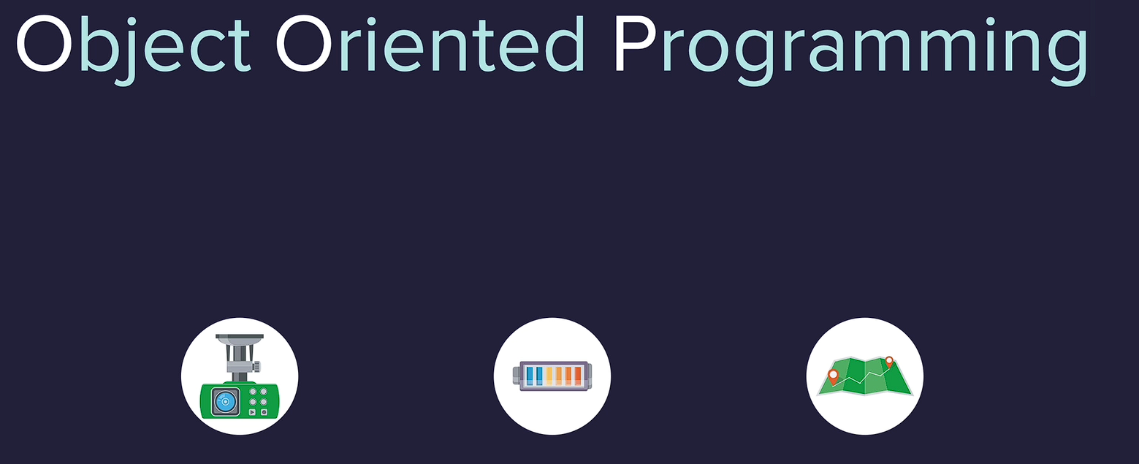

Slide 35
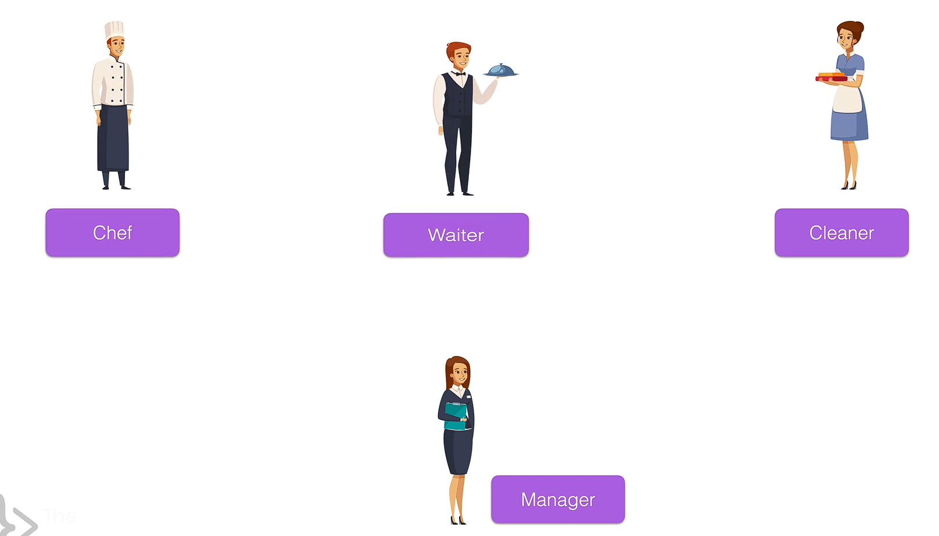

Slide 36
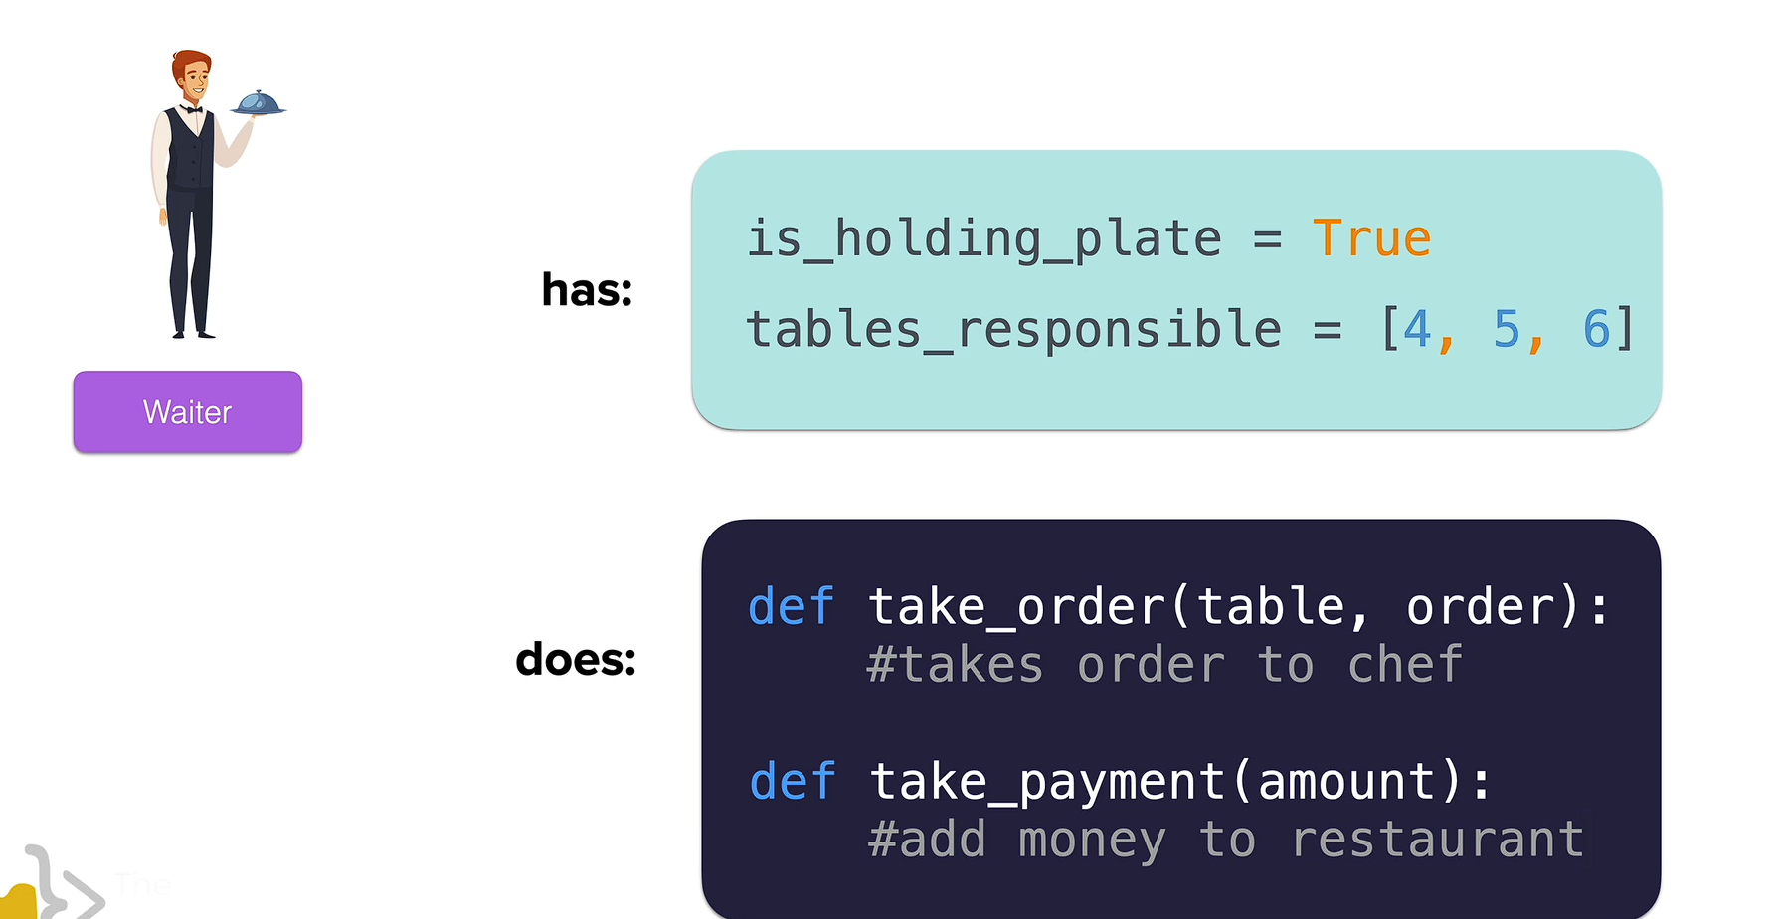
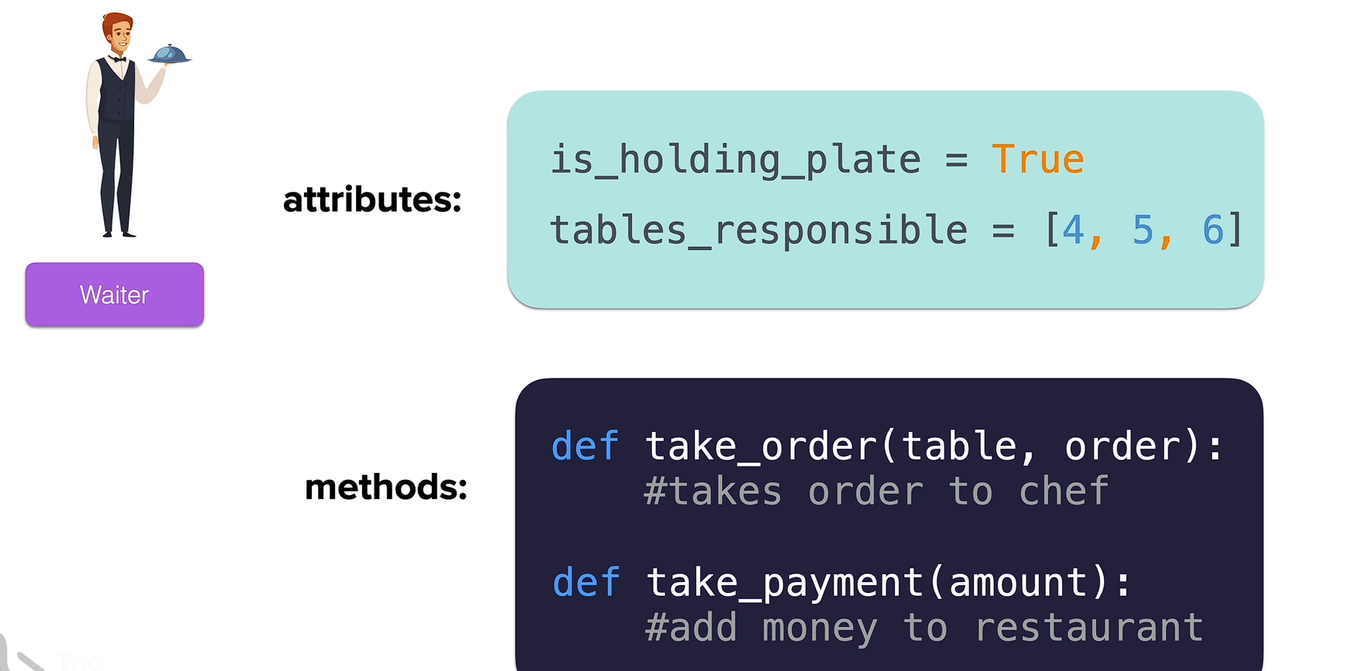
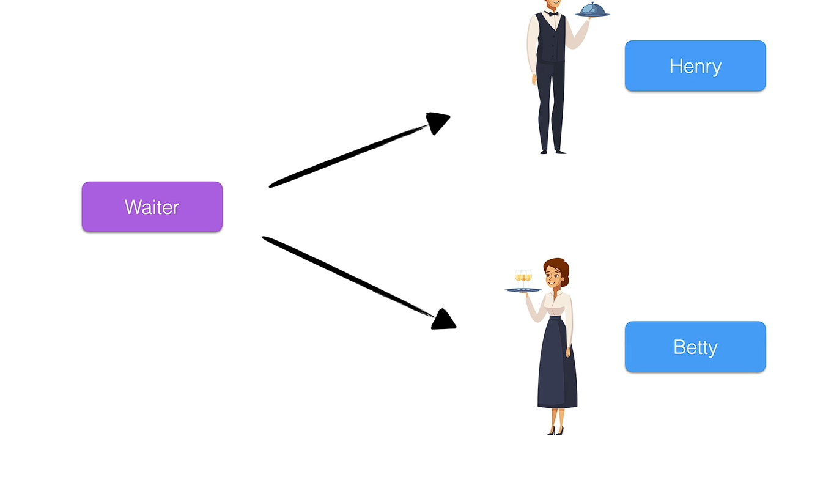

Slide 37


Slide 38
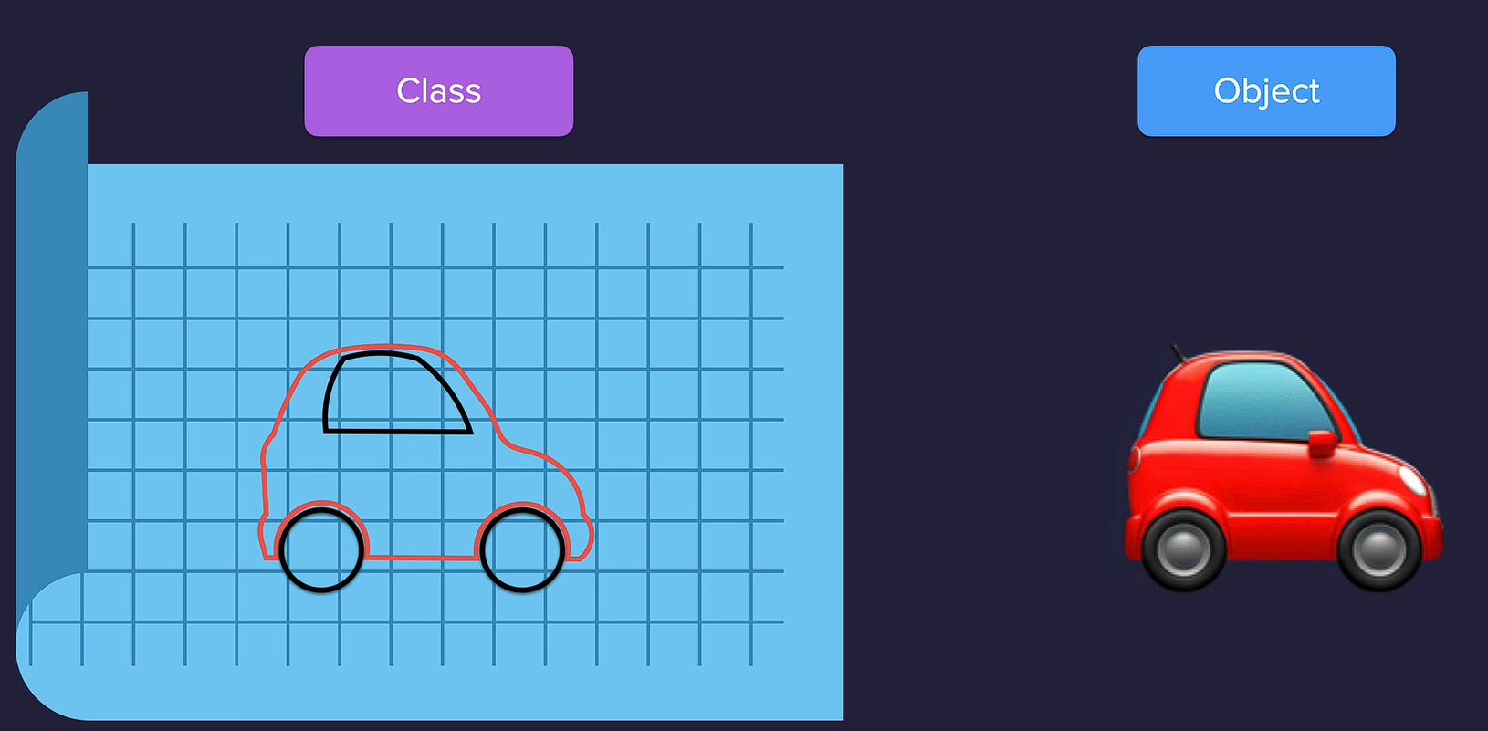
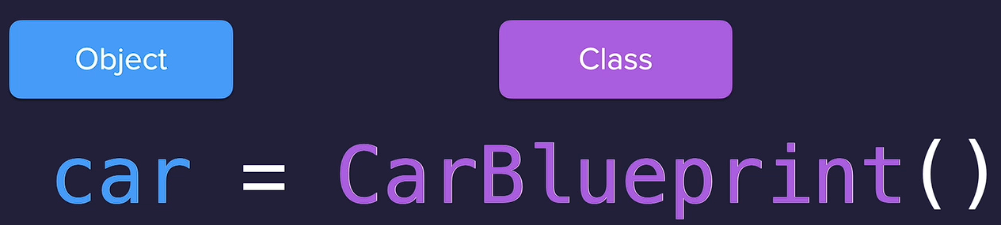

Slide 39

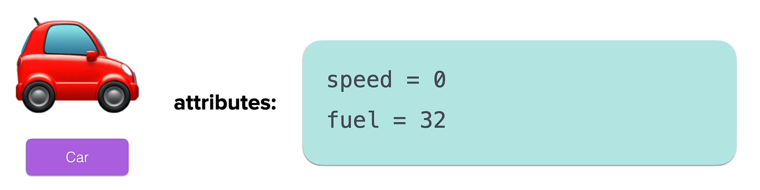
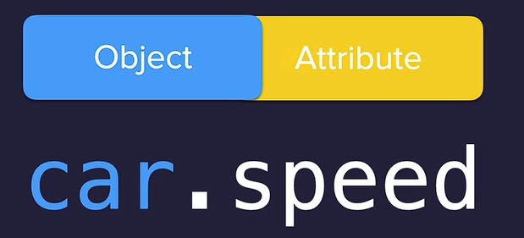

Slide 40

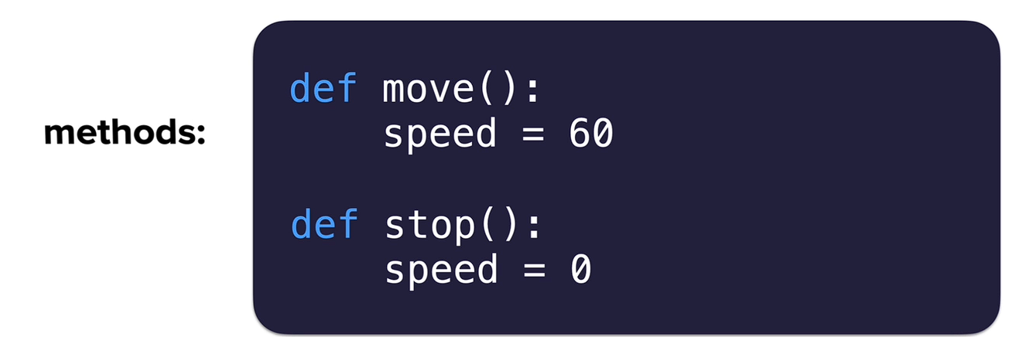
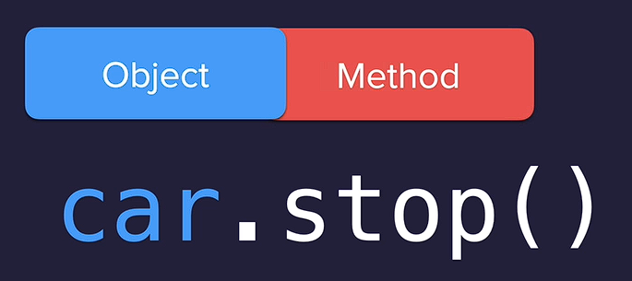

Slide 41

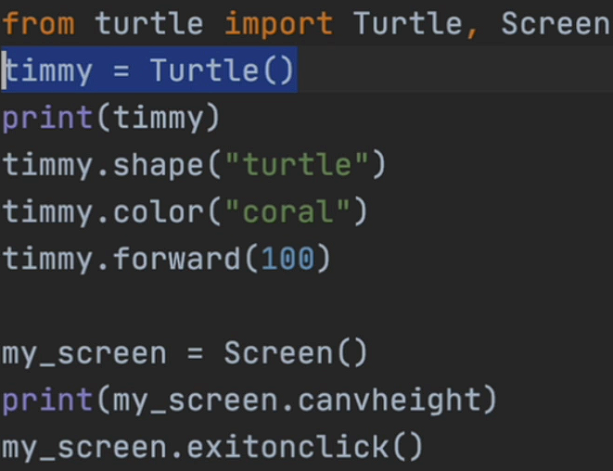

Slide 42

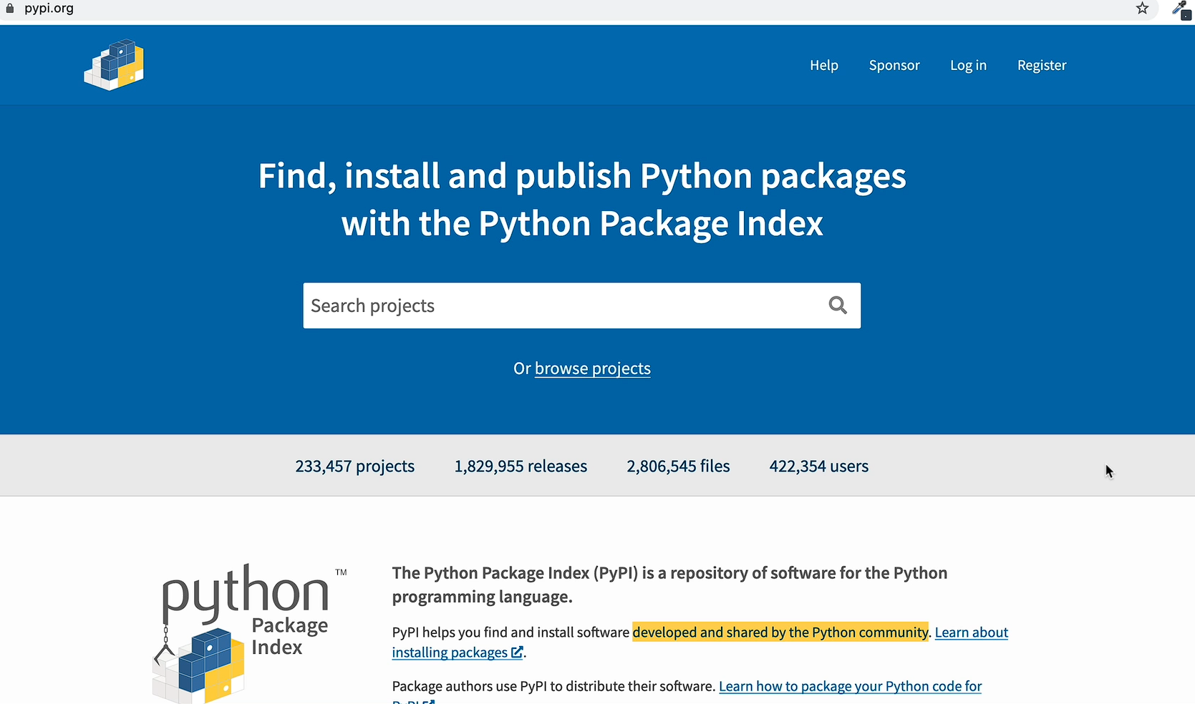

Slide 43
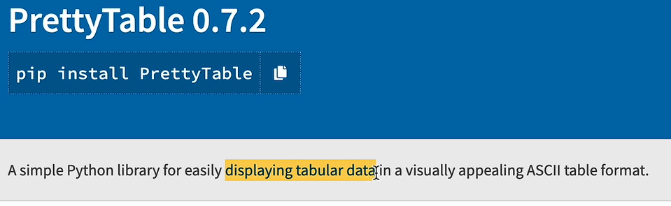
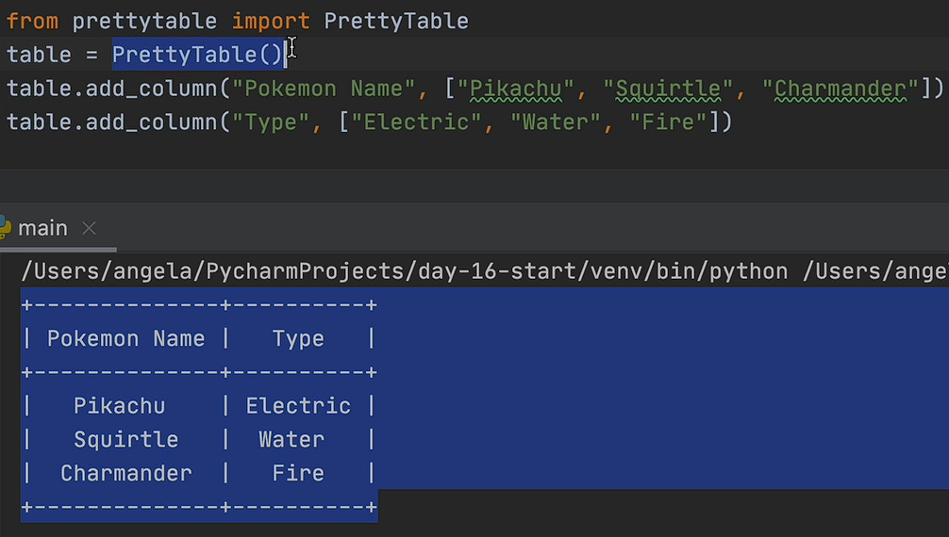

Slide 45
Web development Starts from here

Slide 46
Bootstrap

Slide 47
Web development + intermediate level Starts from here

Slide 48
Advanced level Starts from here

Slide 49
Final level Projects Starts from here

Slide 50
SQL

Slide 51
Site for practice: https://www.sql-practice.com/
Solution Video Link
https://www.youtube.com/watch?v=nYmoQ4r0DVw&ab_channel=BuildwithAkshit

